Slide 1
CET105 Computational Thinking
Title of presentation – something that describes the “problem” you are addressing
Student Name / Student Number

Slide 2
Introduction / Background
A statement of what the problem is e.g. to investigate how the COVID-19 case rates for the UK have developed over time.
Background info on the pandemic, how it started, key dates etc.
If your problem is related to a wider problem addressed by your study group include the wider problem and the specific aspect that you will be dealing with.

Slide 3
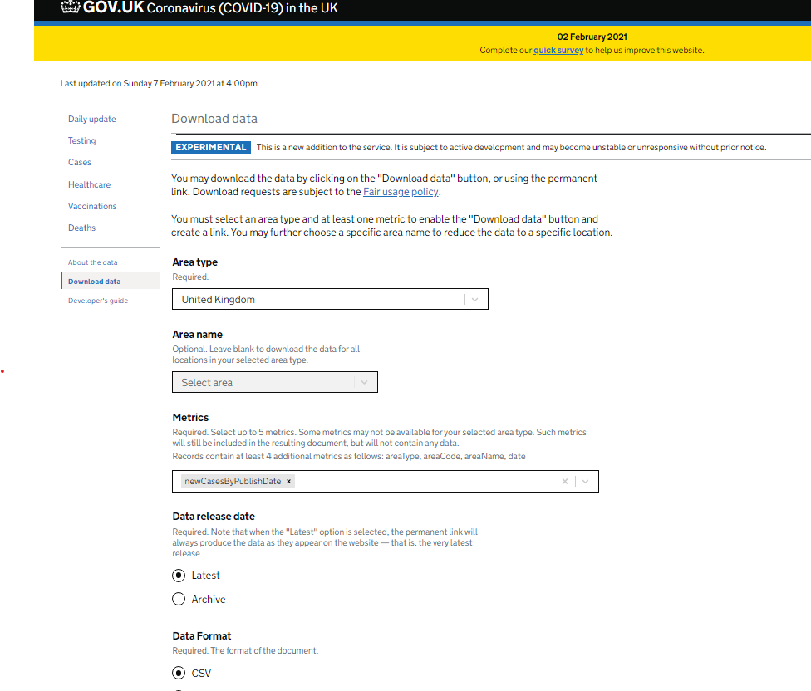
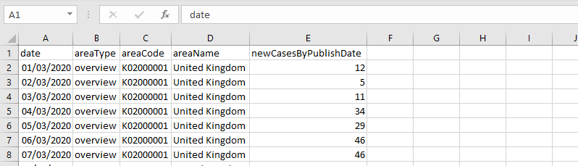
Data and Method
Explain where/how you obtained the data
Explain any filters used (if obtained from Government dataset)
List metrics selected e.g. newCasesByPublishDate
Give an example of your downloaded data

Slide 4
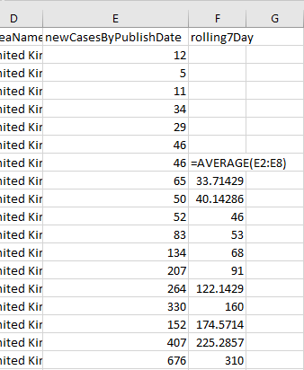
Data Analysis
What you did with your data
Perhaps adding columns, sorting in Excel
Calculations on data e.g. calculating rolling 7 day average, mean data values per month etc.
Merging/combining/filtering data
Calculations should be appropriate to the problem you are trying to solve e.g. if you want to compare data for each month then you might calculate a mean across all dates in a month (for each month)
If you wanted to calculate the variation of cases from day to day across a month/week then you might use standard deviations

Slide 5
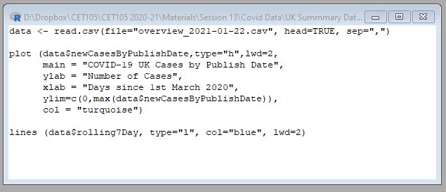
Data Analysis
If you have written an R script to process your data then include a slide to explain your code
If you have used Excel (or other) package to produce plots then include a slide to explain how you produced your charts

Slide 6
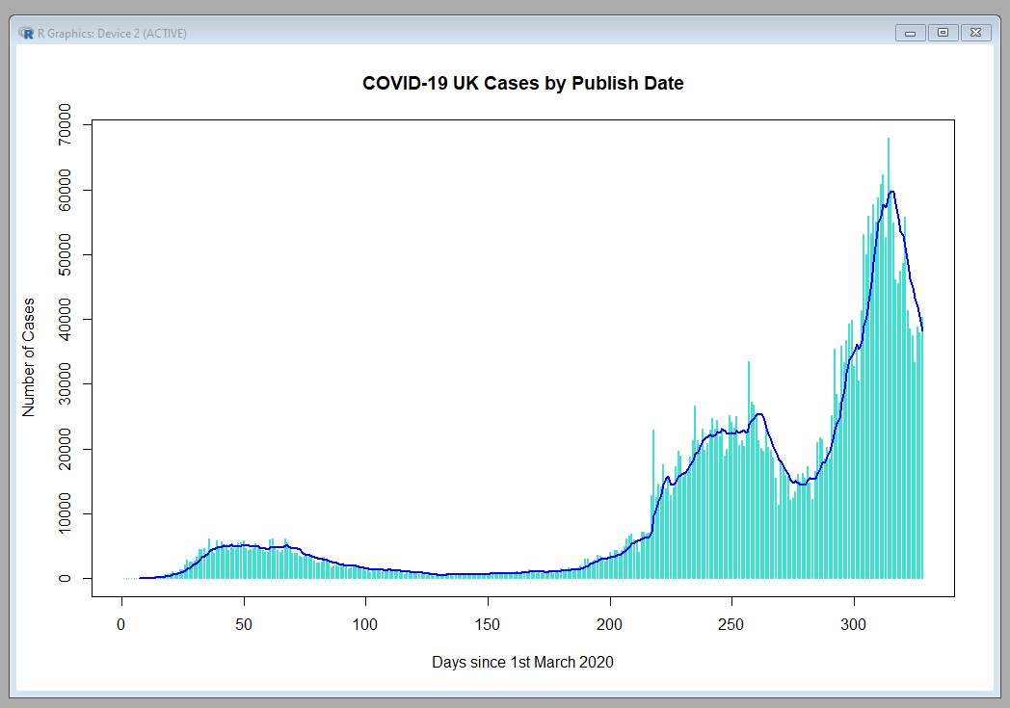
Results / Data Visualisation
Include any plots produced to illustrate your data/results
Might be a range of plots/charts
Ensure they are clear – split across slides if necessary

Slide 7
Conclusions
Summarise what you have learnt from the results of your data analysis
Link back and draw conclusions related to your “problem”
Suggestions for any future work/analysis that might be useful

Slide 8
Self-evaluation
A summary of what you have learned from tackling this assessment in terms of knowledge, understanding and skills. In particular you should identify and discuss the computer science and/or computational thinking skills and techniques you have developed

Slide 9
Closing Slide
Thank the audience
Should lead into Any Questions?

